Slide 1
Announcements
Schedule change
HW 2 due date pushed back to Tues. 2/26
Exam 1 pushed back to 2/28
Future homework & exam dates will be updated accordingly.

Slide 2

Help a plumber out!
Mario and Peach want to spend Valentine’s day together.
Notes:
Linear search, Insertion sort, Binary search, Merge sort, Quick sort.

Slide 3

Help a plumber out!
But Bowser has taken peach and hid her in the kingdom! :(
Notes:
Linear search, Insertion sort, Binary search, Merge sort, Quick sort.

Slide 4
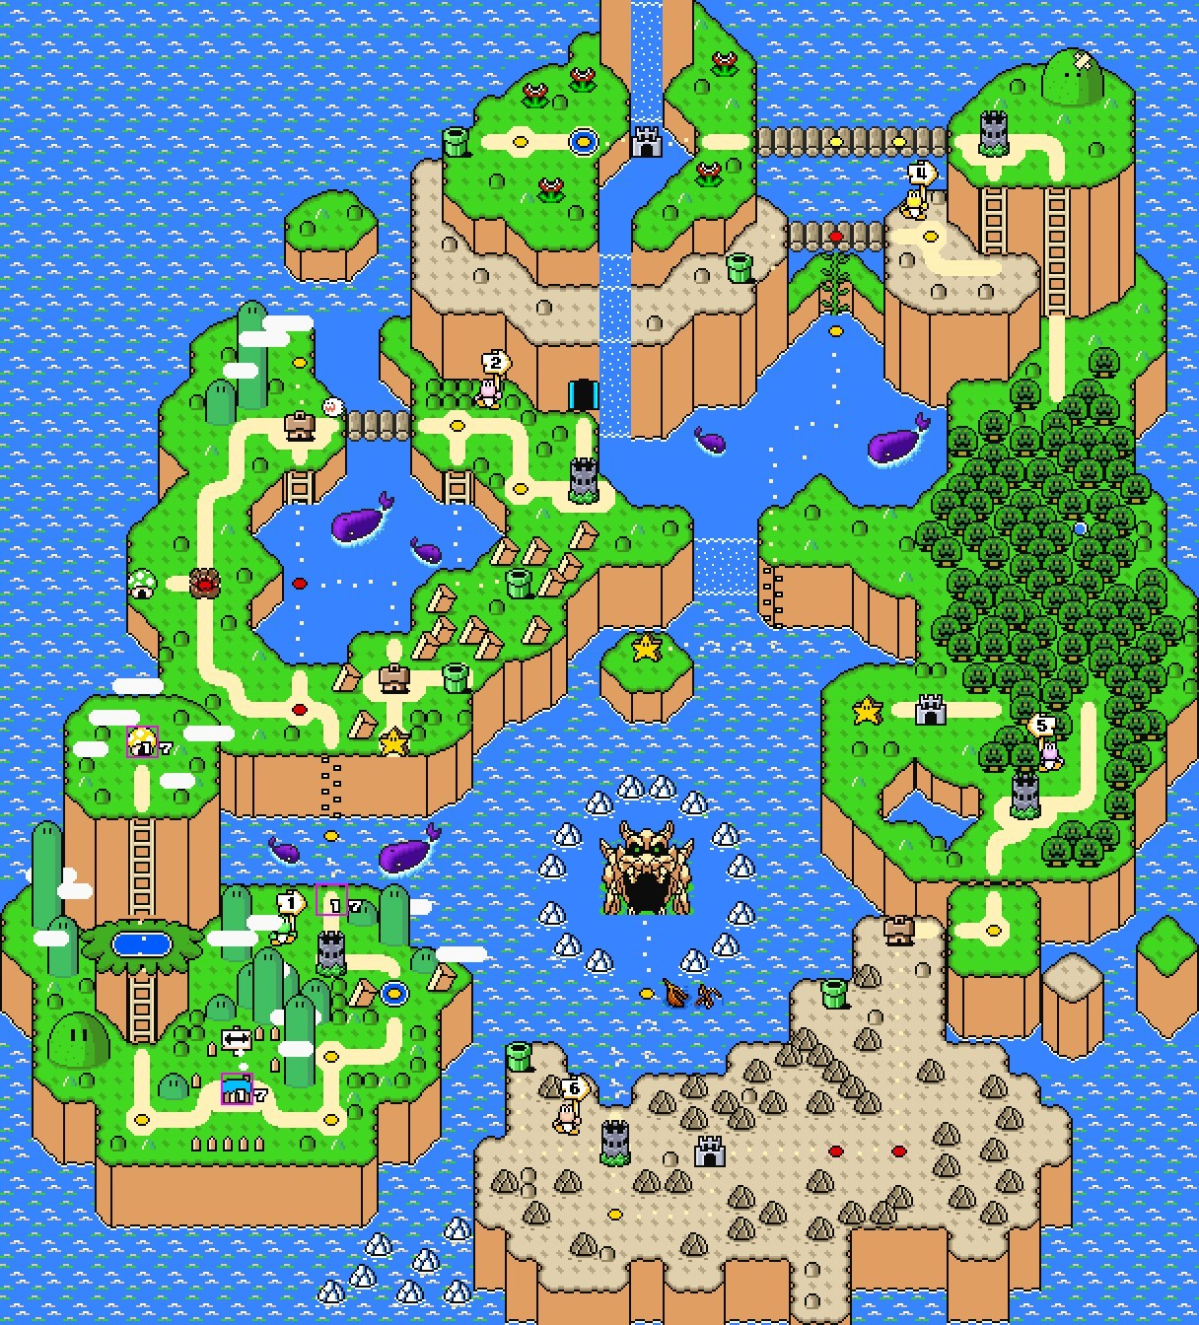
Help a plumber out!
How can we help mario find peach before the end of the day?
Notes:
Linear search, Insertion sort, Binary search, Merge sort, Quick sort.

Slide 5
CST 370 – ADVANCED ALGORITHMS
8.1 Graph Representations

Slide 6
Objectives
You will be able to…
Recall the informal and formal definition of a graph.
Represent a graph using adjacency list notation.
Create an adjacency list given a set of nodes and edges.
Notes:
Linear search, Insertion sort, Binary search, Merge sort, Quick sort.

Slide 7
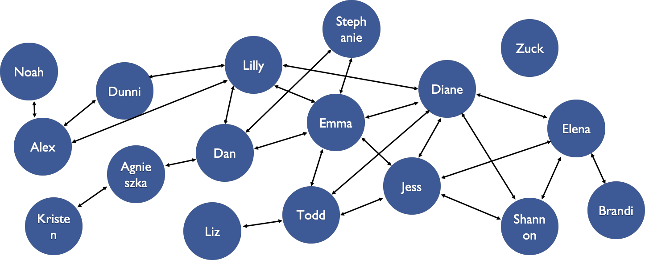
Graphs
Informal Definition
A graph is a data structure that models connections between different items.
Notes:
Linear search, Insertion sort, Binary search, Merge sort, Quick sort.

Slide 8
Graphs
Use Cases
Graphs have a ENORMOUS number of use cases.
Geographic locations (flight finding, driving/walking directions, air traffic routes, etc.)
Transportation systems (design, directions, etc.)
Recommendation engines
Page rank algorithms
Network routing
AI for game playing
Matching problems (i.e., organ donors to patients)
Scheduling problems (i.e., MLB season calendar)
Clustering/classification problems (i.e., diseases, species, consumer markets, text for natural language processing)
Robotics

Slide 9
Graphs
Formal Definition
A graph is a set of vertices and a set of edges between two vertices.
Vertices (singular: vertex) is just the term for nodes in graphs. One vertex/node represents a distinct item that holds some data.
Edges are the relationships or connections between two nodes.
Notes:
Linear search, Insertion sort, Binary search, Merge sort, Quick sort.

Slide 10
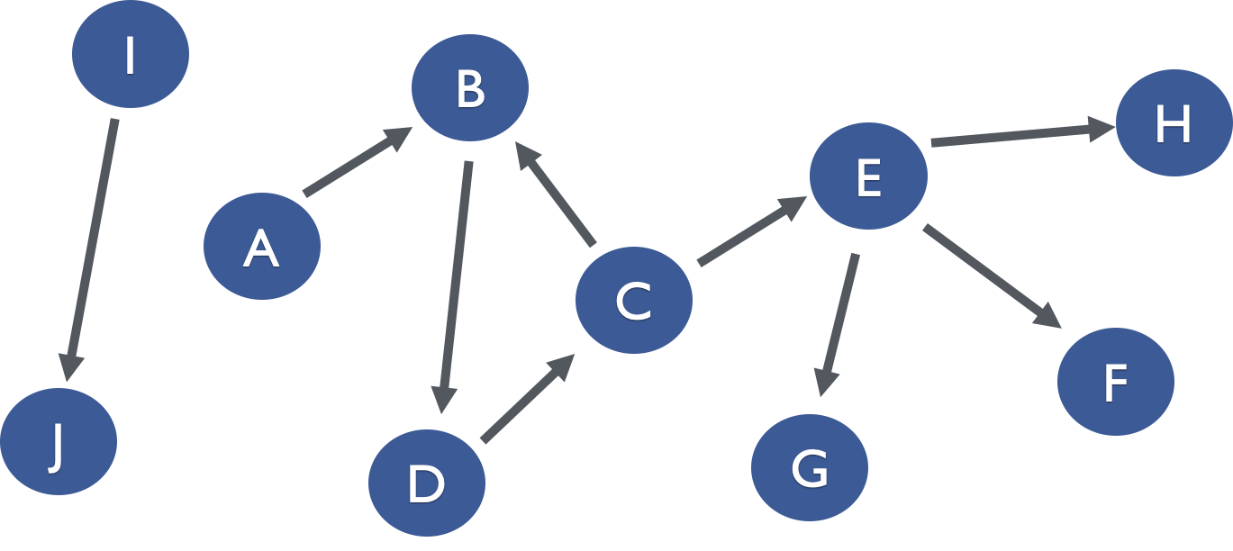
Graphs
Formal Definition
Vertices(10):
A B
C D
E F
G H
I J
Edges(9):
A-B
B-D
C-B
C-E
D-C
E-F
E-H
E-G
I-J
Notes:
Linear search, Insertion sort, Binary search, Merge sort, Quick sort.

Slide 11
Graphs
Properties
Edges are key to a number of properties on graphs:
Graphs may be directed or undirected.
Graphs may be acyclic or cyclic.
Graphs may be connected or unconnected.
Notes:
Linear search, Insertion sort, Binary search, Merge sort, Quick sort.

Slide 12
Cyclic Graph
I
B
H
E
A
C
F
J
D
G

Slide 13
Acyclic Graph
I
B
H
E
A
C
F
J
D
G

Slide 14
Unconnected Graph
I
B
H
E
A
C
F
J
D
G

Slide 15
Connected Graph
I
B
H
E
A
C
F
J
D
G

Slide 16
Directed Graph
I
B
H
E
A
C
F
J
D
G

Slide 17
Directed Graph
I
B
H
E
A
C
F
J
D
G

Slide 18
Graphs
Example: Mushroom kingdom
Vertices/Nodes: different locations where Peach might be
Edges: paths between the different locations.
Is this graph directed?
Is it cyclic?
Is it connected?
Notes:
Linear search, Insertion sort, Binary search, Merge sort, Quick sort.

Slide 19
Graphs
Representations
Recall how we represented a binary tree using a Node struct:
struct TreeNode {
string data;
TreeNode *left;
TreeNode *right;
};

Slide 20
Graphs
Representations
We can also represent a graph using a Node struct as we did a binary tree, storing an array of neighbors instead of left and right children.
struct GraphNode {
string data;
vector<GraphNode *> neighbors;
};

Slide 21
Graphs
Representations
Whereas we represented an entire tree by a single node – its root – we represent a graph by an array of all its nodes:
vector<GraphNode *> vertices

Slide 22
Graphs
Representations
Whereas we represented an entire tree by a single node – its root – we represent a graph by an array of all its nodes:
vector<GraphNode *> vertices
This is called an adjacency list representation of a graph.

Slide 23
Graphs
Representations
Whereas we represented an entire tree by a single node – its root – we represent a graph by an array of all its nodes:
vector<GraphNode *> vertices
This is called an adjacency list representation of a graph.
Why can we not just use a root node?

Slide 24
Graphs
Representations
Whereas we represented an entire tree by a single node – its root – we represent a graph by an array of all its nodes:
vector<GraphNode *> vertices
This is called an adjacency list representation of a graph.
Why can we not just use a root node?
In an unconnected graph, we will not be able to reach all nodes in the graph from any single starting point!

Slide 25
Graphs
Representations
Adjacency Lists are just one of many ways to represent graphs in code.
Adjacency Lists make it easy to ask “who are my neighbors?”
Adjacency Lists are hard to read in as input. (You may reference nodes before they’re created).

Slide 26
Repl.it Demo
Creating Adjacency Lists from input
Adjacency Lists are one of the most common ways to represent graphs and are used throughout Homework 2.
https://www.hackerrank.com/contests/cst370-s19-hw2/challenges/hw2-trains
https://repl.it/@dsyang/TransformingGraphInput (for creating your own input)
http://repl.it/@dsyang/ReadingGraphInput

Slide 27
CST 370 – ADVANCED ALGORITHMS
8.2 Breadth-First Search & Depth-First Search

Slide 28
Graphs
Traversals
Suppose Mario wants to put“Have you seen Peach?” posters at every location in Mushroom Kingdom.

Slide 29
Graphs
Searches
Suppose Peach wants look for mario within Mushroom Kingdom.

Slide 30
Graphs
Searches/Traversals
For both of these problems, there are two options:
We can first follow one path (i.e., pick a location, then an adjacent location, then an adjacent location’s adjacent location, etc…) and traverse it until there are no more options, then backtrack and pick a different adjacent location and continue until there are no more options.

Slide 31
Graphs
Searches/Traversals
For both of these problems, there are two options:
We can first follow one path (i.e., pick a location, then an adjacent location, then an adjacent location’s adjacent location, etc…) and traverse it until there are no more options, then backtrack and pick a different adjacent location and continue until there are no more options. This is called depth-first search (DFS).

Slide 32
Graphs
Searches/Traversals
The other option is:
We can first look at all my adjacent locations, then look at all adjacent locations to those locations, then keep looking at all adjacent locations to locations we’ve already visited and continue until there are no more options.

Slide 33
Graphs
Searches/Traversals
The other option is:
We can first look at all my adjacent locations, then look at all adjacent locations to those locations, then keep looking at all adjacent locations to locations we’ve already visited and continue until there are no more options. This is called breadth-first search (BFS).

Slide 34
Graphs
Searches/Traversals
For both of these problems, there are two options:
DFS (Depth-First Search): so-called because we completely explore one possible path before exploring other possibilities (we go deep before we go wide).
BFS (Breadth-First Search): so-called because we explore all possible paths in parallel (we go wide before we go deep).

Slide 35

Graphs
DFS Example
Stephanie
Zuck
Noah
Lilly
Dunni
Diane
Emma
Elena
Alex
Alex
Danielle
Agnieszka
Jess
Todd
Brandi
Kristen
Liz
Shannon

Slide 36
Graphs
DFS Example
Stephanie
Zuck
Noah
Lilly
Dunni
Diane
Emma
Elena
Alex
Alex
Danielle
Agnieszka
Jess
Todd
Brandi
Kristen
Liz
Shannon

Slide 37
Graphs
DFS Example
Stephanie
Zuck
Noah
Lilly
Dunni
Diane
Emma
Elena
Alex
Alex
Danielle
Agnieszka
Jess
Todd
Brandi
Kristen
Liz
Shannon

Slide 38
Graphs
DFS Example
Stephanie
Zuck
Noah
Lilly
Dunni
Diane
Emma
Elena
Alex
Alex
Danielle
Agnieszka
Jess
Todd
Brandi
Kristen
Liz
Shannon

Slide 39
Graphs
DFS Example
Stephanie
Zuck
Noah
Lilly
Dunni
Diane
Emma
Elena
Alex
Alex
Danielle
Agnieszka
Jess
Todd
Brandi
Kristen
Liz
Shannon

Slide 40
Graphs
DFS Example
Stephanie
Zuck
Noah
Lilly
Dunni
Diane
Emma
Elena
Alex
Alex
Danielle
Agnieszka
Jess
Todd
Brandi
Kristen
Liz
Shannon

Slide 41
Graphs
DFS Example
Stephanie
Zuck
Noah
Lilly
Dunni
Diane
Emma
Elena
Alex
Alex
Danielle
Agnieszka
Jess
Todd
Brandi
Kristen
Liz
Shannon

Slide 42
Graphs
DFS Example
Stephanie
Zuck
Noah
Lilly
Dunni
Diane
Emma
Elena
Alex
Alex
Danielle
Agnieszka
Jess
Todd
Brandi
Kristen
Liz
Shannon

Slide 43
Graphs
DFS Example
Stephanie
Zuck
Noah
Lilly
Dunni
Diane
Emma
Elena
Alex
Alex
Danielle
Agnieszka
Jess
Todd
Brandi
Kristen
Liz
Shannon

Slide 44
Graphs
DFS Example
Stephanie
Zuck
Noah
Lilly
Dunni
Diane
Emma
Elena
Alex
Alex
Danielle
Agnieszka
Jess
Todd
Brandi
Kristen
Liz
Shannon

Slide 45
Graphs
DFS Example
Stephanie
Zuck
Noah
Lilly
Dunni
Diane
Emma
Elena
Alex
Alex
Danielle
Agnieszka
Jess
Todd
Brandi
Kristen
Liz
Shannon

Slide 46
Graphs
DFS Example
Stephanie
Zuck
Noah
Lilly
Dunni
Diane
Emma
Elena
Alex
Alex
Danielle
Agnieszka
Jess
Todd
Brandi
Kristen
Liz
Shannon

Slide 47
Graphs
DFS Example
Stephanie
Zuck
Noah
Lilly
Dunni
Diane
Emma
Elena
Alex
Alex
Danielle
Agnieszka
Jess
Todd
Brandi
Kristen
Liz
Shannon

Slide 48
Graphs
DFS Example
Stephanie
Zuck
Noah
Lilly
Dunni
Diane
Emma
Elena
Alex
Alex
Danielle
Agnieszka
Jess
Todd
Brandi
Kristen
Liz
Shannon

Slide 49
Graphs
DFS Example
Stephanie
Zuck
Noah
Lilly
Dunni
Diane
Emma
Elena
Alex
Alex
Danielle
Agnieszka
Jess
Todd
Brandi
Kristen
Liz
Shannon

Slide 50
Graphs
DFS Example
Stephanie
Zuck
Noah
Lilly
Dunni
Diane
Emma
Elena
Alex
Alex
Danielle
Agnieszka
Jess
Todd
Brandi
Kristen
Liz
Shannon

Slide 51
Graphs
BFS Example
Stephanie
Zuck
Noah
Lilly
Dunni
Diane
Emma
Elena
Alex
Alex
Danielle
Agnieszka
Jess
Todd
Brandi
Kristen
Liz
Shannon

Slide 52
Graphs
BFS Example
Stephanie
Zuck
Noah
Lilly
Dunni
Diane
Emma
Elena
Alex
Alex
Danielle
Agnieszka
Jess
Todd
Brandi
Kristen
Liz
Shannon

Slide 53
Graphs
BFS Example
Stephanie
Zuck
Noah
Lilly
Dunni
Diane
Emma
Elena
Alex
Alex
Danielle
Agnieszka
Jess
Todd
Brandi
Kristen
Liz
Shannon

Slide 54
Graphs
BFS Example
Stephanie
Zuck
Noah
Lilly
Dunni
Diane
Emma
Elena
Alex
Alex
Danielle
Agnieszka
Jess
Todd
Brandi
Kristen
Liz
Shannon

Slide 55
Graphs
BFS Example
Stephanie
Zuck
Noah
Lilly
Dunni
Diane
Emma
Elena
Alex
Alex
Danielle
Agnieszka
Jess
Todd
Brandi
Kristen
Liz
Shannon

Slide 56
Graphs
BFS Example
Stephanie
Zuck
Noah
Lilly
Dunni
Diane
Emma
Elena
Alex
Alex
Danielle
Agnieszka
Jess
Todd
Brandi
Kristen
Liz
Shannon

Slide 57
Graphs
BFS Example
Stephanie
Zuck
Noah
Lilly
Dunni
Diane
Emma
Elena
Alex
Alex
Danielle
Agnieszka
Jess
Todd
Brandi
Kristen
Liz
Shannon

Slide 58
Graphs
BFS Example
Stephanie
Zuck
Noah
Lilly
Dunni
Diane
Emma
Elena
Alex
Alex
Danielle
Agnieszka
Jess
Todd
Brandi
Kristen
Liz
Shannon

Slide 59
Graphs
BFS Example
Stephanie
Zuck
Noah
Lilly
Dunni
Diane
Emma
Elena
Alex
Alex
Danielle
Agnieszka
Jess
Todd
Brandi
Kristen
Liz
Shannon

Slide 60
Graphs
BFS Example
Stephanie
Zuck
Noah
Lilly
Dunni
Diane
Emma
Elena
Alex
Alex
Danielle
Agnieszka
Jess
Todd
Brandi
Kristen
Liz
Shannon

Slide 61
Graphs
BFS Example
Stephanie
Zuck
Noah
Lilly
Dunni
Diane
Emma
Elena
Alex
Alex
Danielle
Agnieszka
Jess
Todd
Brandi
Kristen
Liz
Shannon

Slide 62
Graphs
BFS Example
Stephanie
Zuck
Noah
Lilly
Dunni
Diane
Emma
Elena
Alex
Alex
Danielle
Agnieszka
Jess
Todd
Brandi
Kristen
Liz
Shannon

Slide 63
Graphs
BFS Example
Stephanie
Zuck
Noah
Lilly
Dunni
Diane
Emma
Elena
Alex
Alex
Danielle
Agnieszka
Jess
Todd
Brandi
Kristen
Liz
Shannon

Slide 64
Graphs
BFS Example
Stephanie
Zuck
Noah
Lilly
Dunni
Diane
Emma
Elena
Alex
Alex
Danielle
Agnieszka
Jess
Todd
Brandi
Kristen
Liz
Shannon

Slide 65
Graphs
BFS Example
Stephanie
Zuck
Noah
Lilly
Dunni
Diane
Emma
Elena
Alex
Alex
Danielle
Agnieszka
Jess
Todd
Brandi
Kristen
Liz
Shannon

Slide 66
Graphs
BFS Example
Stephanie
Zuck
Noah
Lilly
Dunni
Diane
Emma
Elena
Alex
Alex
Danielle
Agnieszka
Jess
Todd
Brandi
Kristen
Liz
Shannon

Slide 67
Graphs
Searches/Traversals
Since a tree is just a specialized form of a graph, tree traversals (Pre-, In-, Post-, and Level-Order) are just specialized forms of DFS and BFS.

Slide 68
Graphs
Searches/Traversals
Since a tree is just a specialized form of a graph, tree traversals (Pre-, In-, Post-, and Level-Order) are just specialized forms of DFS and BFS.
Which is which?

Slide 69
Tree Traversals: How can we classify tree traversals as BFS or DFS?
Pre-, in-, and & post-order are DFS; level-order is BFS
Pre-, in-, and & post-order are BFS; level-order is DFS
Pre-order & post-order are DFS; in-order & level-order are BFS
Pre-order & post-order are BFS; in-order & level-order are DFS
They are all DFS
They are all BFS

Slide 70
Graphs
Searches/Traversals
Since a tree is just a specialized form of a graph, tree traversals (Pre-, In-, Post-, and Level-Order) are just specialized forms of DFS and BFS.
Which is which?
DFS: Pre-Order, In-Order, & Post-Order traversals
BFS: Level-Order traversal

Slide 71
Graphs
Searches/Traversals
What does it mean to have “no more neighbors left to visit”?

Slide 72
Graphs
Searches/Traversals
What does it mean to have “no more neighbors left to visit”?
In a tree it meant we reached a leaf

Slide 73
Graphs
Searches/Traversals
What does it mean to have “no more neighbors left to visit”?
In a tree it meant we reached a leaf
But in a graph we could have no more neighbors left without reaching a “leaf” (we don’t use the term leaf for graphs)

Slide 74
Graphs
Searches/Traversals
What does it mean to have “no more neighbors left to visit”?
In a tree it meant we reached a leaf
But in a graph we could have no more neighbors left without reaching a “leaf” (we don’t use the term leaf for graphs)
We are out of options when we have already visited all the neighbors at some point

Slide 75
Graphs
Searches/Traversals
What does it mean to have “no more neighbors left to visit”?
In a tree it meant we reached a leaf
But in a graph we could have no more neighbors left without reaching a “leaf” (we don’t use the term leaf for graphs)
We are out of options when we have already visited all the neighbors at some point
To avoid infinitely traversing a cycle, we must keep track of which nodes we have already visited in both DFS and BFS

Slide 76
Repl.it Demo
Help Mario and Peach find each other.
By implementing BFS.
http://repl.it/@dsyang/ReadingGraphInput

Slide 77
Now it’s your turn!
Help Mario and Peach find each other.
By implementing DFS to help Mario and Peach find each other.
https://www.hackerrank.com/contests/cst370-s19-hw2/challenges/hw2-trains
https://repl.it/@dsyang/TransformingGraphInput (for creating your own input)
http://repl.it/@dsyang/ReadingGraphInput

Slide 78
In-class work credit
CST370-S19_Lesson8_InClass
Password is: Monkey

